Slide 1

Geometry
Unit 12, Lesson 8 general Form of a Circle Volume 2, pg. 266

Slide 2


Benchmarks
MA.912.GR.7.2
Given a mathematical or real-world context, derive and create the equation of a circle using key features.
MA.912.GR.7.3
Graph and solve mathematical and real-world problems that are modeled with an equation of a circle. Determine and interpret key features in terms of context.
volume 2, pg. 266

Slide 3
Integrated Mathematical Thinking and Reasoning Standards
MA.K12.MTR.1.1 Actively participate in effortful learning both individually and collectively.
MA.K12.MTR.2.1 Demonstrate understanding by representing problems in multiple ways.
MA.K12.MTR.4.1 Engage in discussions that reflect on the mathematical thinking of self and others.
MA.K12.MTR.5.1 Use patterns and structure to help understand and connect mathematical concepts.
volume 2, pg. 266

Slide 4

Learning Targets
I can rewrite the equation of a circle from general form to center-radius form.
I can determine key features of a circle given the equation in general form.
I can write the domain and range using inequality notation, interval notation, or set-builder notation.
volume 2, pg. 266

Slide 5

Warm-Up
volume 2, pg. 267

Slide 6
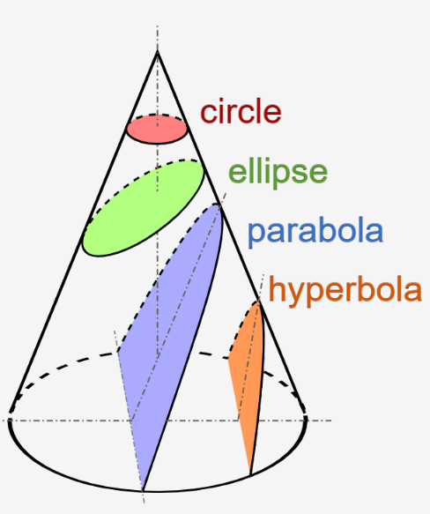
12.8.1 Warm-Up: Conic Sections
Conic sections are the family of curves created when a plane slices through a cone. A circle is best known as a conic section. A diagram of five conic sections is shown.
According to Greek philosopher Proclus, Menaechmus, a member of Plato’s Academy, discovered conic sections around 350 B.C. Approximately 100 years later, Apollonius, a Greek geometer and astronomer, developed and published the theory of conic sections. His work earned him the title of the Great Geometer.
volume 2, pg. 267

Slide 7
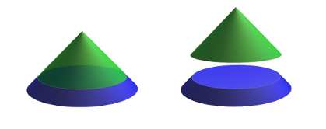
Use the diagram to explain why when a cone is sliced horizontally the result is a circle.
volume 2, pg. 267

Slide 8

Collaboration
volume 2, pg. 267

Slide 9

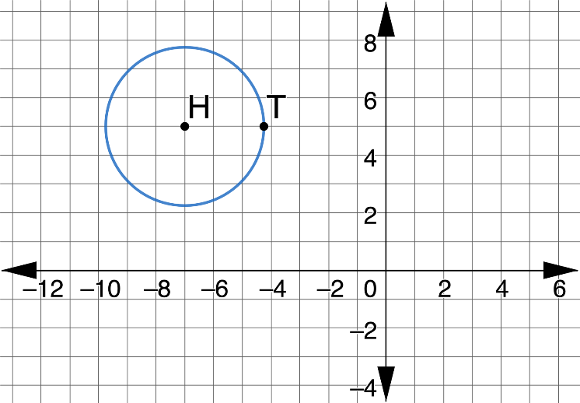
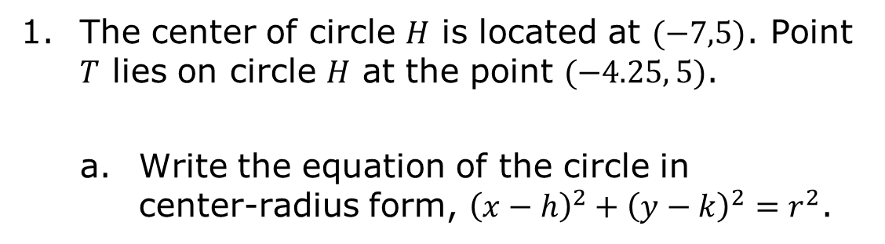
12.8.2 Collaboration: Standard Form
The center of circle $H$ is located at $(−7,5)$. Point $T$ lies on circle $H$ at the point $(−4.25, 5)$.
Write the equation of the circle in center-radius form, ${\left(x−h\right)}^{2}+{\left(y−k\right)}^{2}=r^{2}$.
volume 2, pg. 267

Slide 10

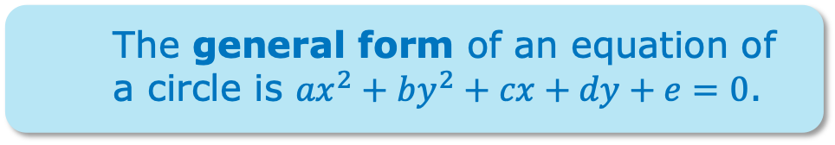
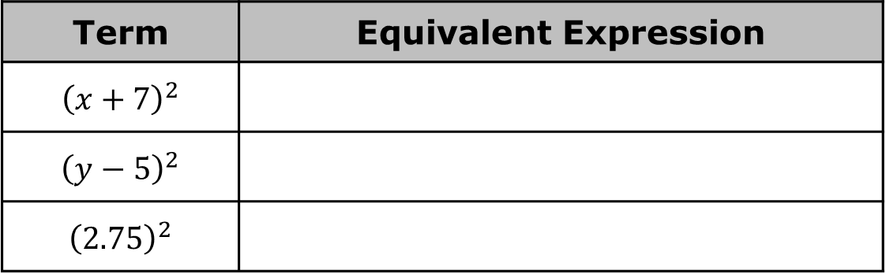

Expand each term of the center-radius form to write an equivalent expression.
Use the equivalent expressions of the center-radius form to rewrite the center-radius form of circle $H$ in general form.
Term | Equivalent Expression
$${\left(x+7\right)}^{2}$$
$${\left(y−5\right)}^{2}$$
$${\left(2.75\right)}^{2}$$
The general form of an equation of a circle is ${ax}^{2}+by^{2}+cx+dy+e=0$.
volume 2, pg. 268

Slide 11

Refresher
volume 2, pg. 268

Slide 12

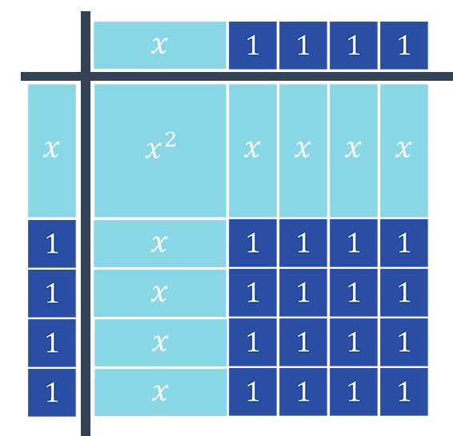
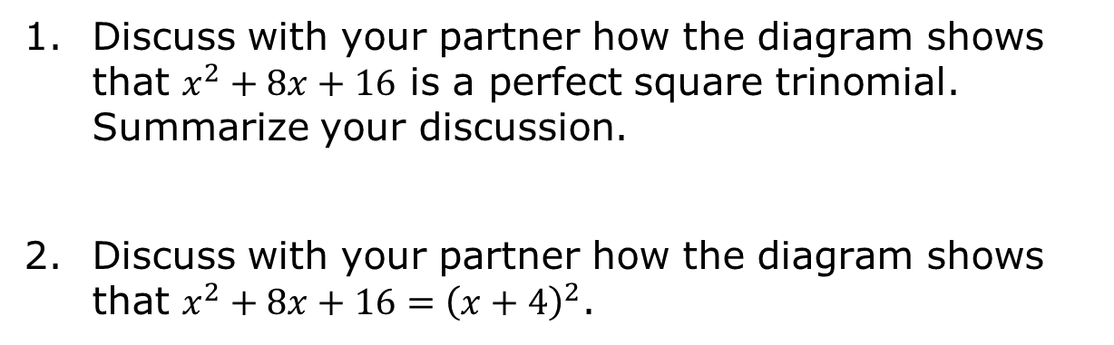
12.8.3 Refresher: Completing the Square
The binomial ${\left(x+4\right)}^{2}$ can be rewritten as $x^{2}+8x+16$, which is a perfect square trinomial. The algebra tiles represent both ${\left(x+4\right)}^{2}$ and $x^{2}+8x+16$.
Discuss with your partner how the diagram shows that $x^{2}+8x+16$ is a perfect square trinomial. Summarize your discussion.
Discuss with your partner how the diagram shows that $x^{2}+8x+16={\left(x+4\right)}^{2}$.
volume 2, pg. 268

Slide 13
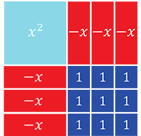
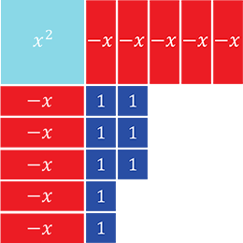

Write the perfect square trinomial and the binomial squared that are represented by the diagram.
The trinomial $x^{2}−10x+8$ is shown.
How many $1$ tiles have to be added to complete the square?
volume 2, pg. 269

Slide 14
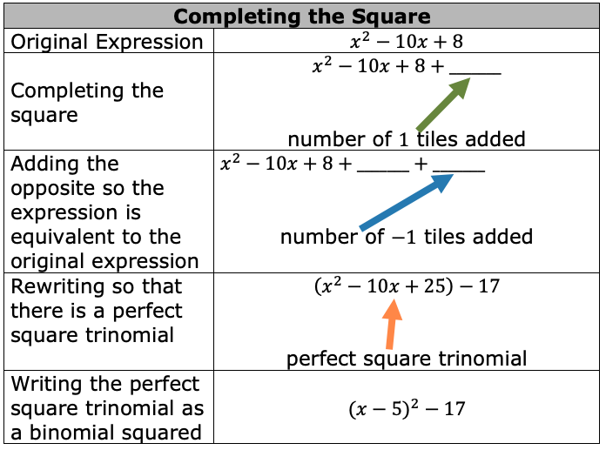
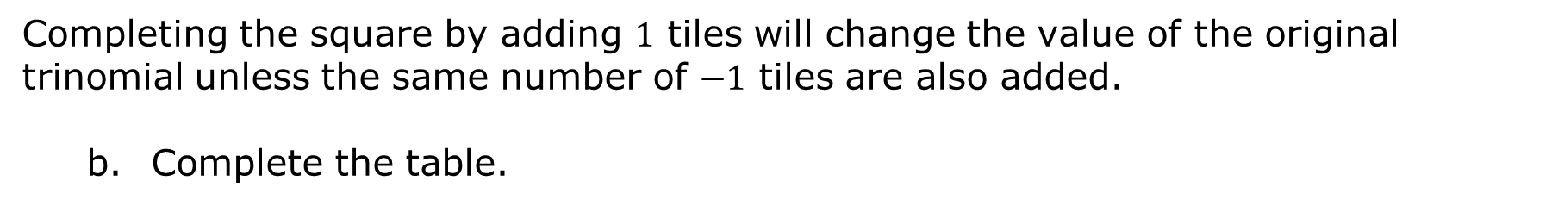
Completing the square by adding $1$ tiles will change the value of the original trinomial unless the same number of $−1$ tiles are also added.
Complete the table.
volume 2, pg. 269

Slide 15

Guided Instruction
volume 2, pg. 270

Slide 16
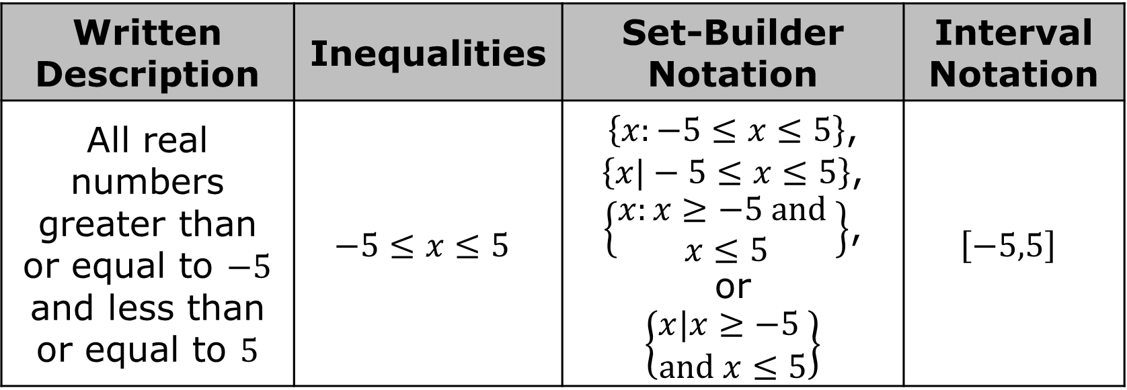
12.8.4 Guided Instruction: Rewriting the General Form of the Equation of a Circle
There are several ways to mathematically represent the domain and range.
Written Description | Inequalities | Set-Builder Notation | Interval Notation
All real numbers greater than or equal to $−5$ and less than or equal to $5$ | $$−5≤x≤5$$ | $\left\{x:−5≤x≤5\right\}$, $\left\{x|−5≤x≤5\right\}$, $\left\{\begin{aligned}x:x≥−5 and \\ x≤5\end{aligned}\right\}$, or $$\left\{\begin{aligned}x|x≥−5 \\ and x≤5\end{aligned}\right\}$$ | $$\left[−5,5\right]$$
volume 2, pg. 270

Slide 17
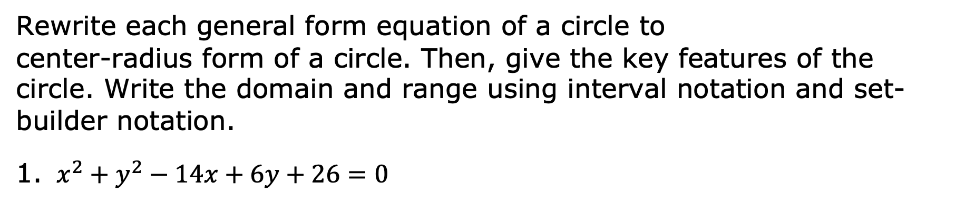
Rewrite each general form equation of a circle to
center-radius form of a circle. Then, give the key features of the circle. Write the domain and range using interval notation and set-builder notation.
$x^{2}+y^{2}−14x+6y+26=0$
Center-Radius Form | Center | Radius
 | Domain | Range
volume 2, pg. 270

Slide 18
$x^{2}+y^{2}−18x−10y=−52$
Center-Radius Form | Center | Radius
 | Domain | Range
volume 2, pg. 270

Slide 19

Guided Practice
volume 2, pg. 271

Slide 20

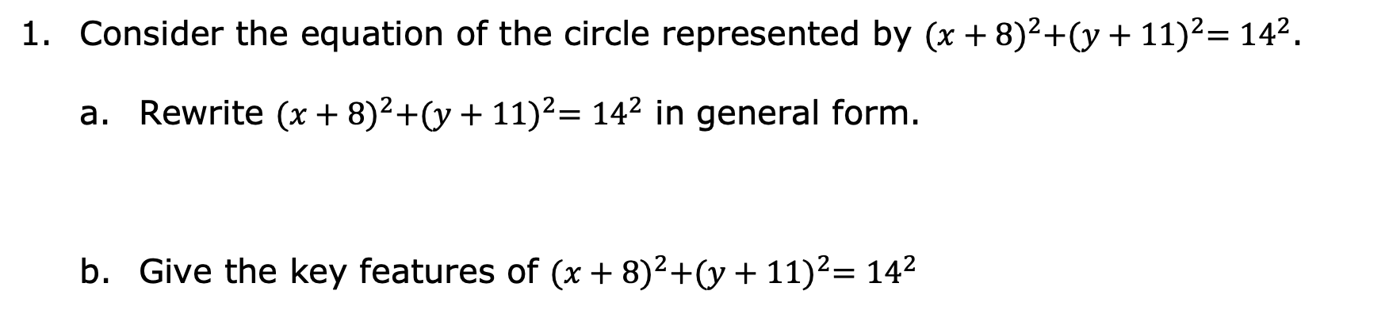
12.8.5 Guided Practice: Converting Forms of a Circle
Consider the equation of the circle represented by ${(x+8)}^{2}+{(y+11)}^{2}={14}^{2}$.
Rewrite ${(x+8)}^{2}+{(y+11)}^{2}={14}^{2}$ in general form.
Give the key features of ${(x+8)}^{2}+{(y+11)}^{2}={14}^{2}$
Center | Diameter | Radius
Domain | Range
volume 2, pg. 271

Slide 21
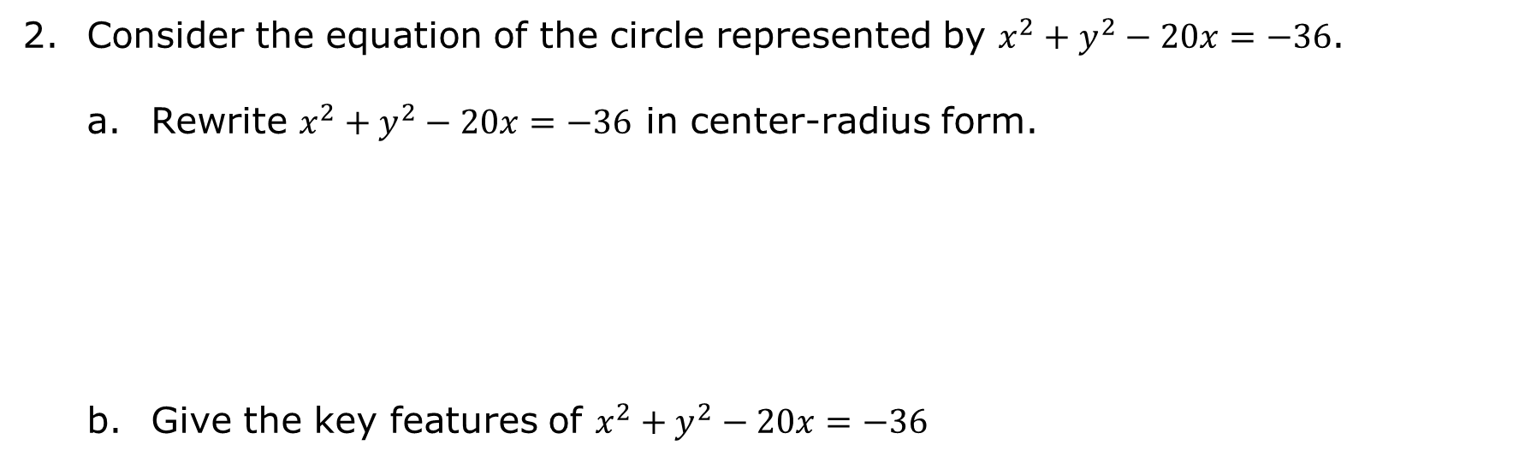
Consider the equation of the circle represented by $x^{2}+y^{2}−20x=−36$.
Rewrite $x^{2}+y^{2}−20x=−36$ in center-radius form.
Give the key features of $x^{2}+y^{2}−20x=−36$
Center | Diameter | Radius
Domain | Range
volume 2, pg. 271

Slide 22

Wrap-Up
volume 2, pg. 272

Slide 23



12.8.6 Wrap-Up: Reflection
Circle the icon that best describes your understanding of each concept.
I need help.
I got it.
I could help someone.
Rewriting center-radius form to general form
Key features of a circle
Completing the square
Rewriting general form to center-radius form
Set-builder notation
Interval notation
volume 2, pg. 272

